Slide 1


King Arthur: The Legend
Archetypes; Historical Context; Synopsis
Name:
Tutor:
Course:
Date:

Slide 2
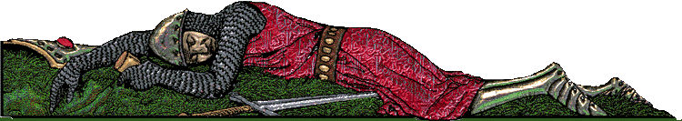
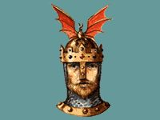
In This Presentation:
Arthur’s connections and Archetypes
Synopsis of the Legend
Historical Context and Themes

Slide 3
The Definition of a Legend
Legends are stories passed down one generation to the next by word of mouth. Legends are traditionalist historical tales or collections of related tales are popularly regarded as true, but nevertheless contain a mixture of fiction and fact (Hardyman & Killcoyne 4).
Legends should not be confused with myths.
Myths are typically ancient traditionalist stories that deal with heroes, ancestors and other supernatural beings serving as fundamental types in a people’s worldview, as by explaining aspects of the natural world or delineating the ideals, customs or psychology of a society (5).

Slide 4
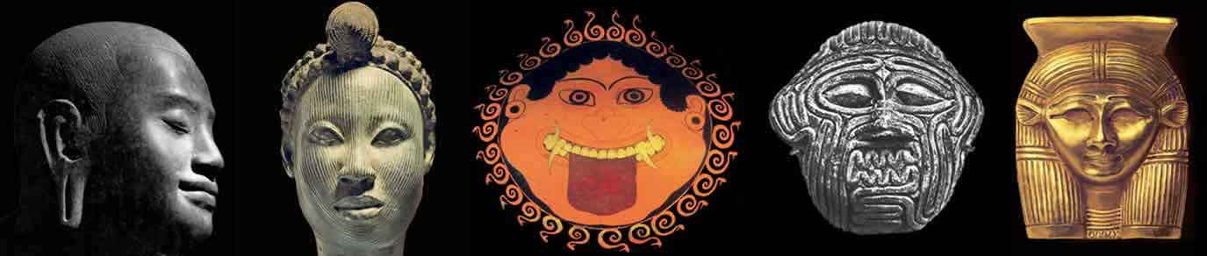
Archetypes
Archetypes are reoccurring character types, settings or actions recognizable cultures and literature and elicits certain reactions or feelings from their readers.
The characters depicted draw on typical human experiences.
The elicit emotional reactions and provide audiences with clues on future motivations or actions.
  They can be compared to moments in superhero movies where one expects certain characters to do certain things (such as the trumping of the hero or destruction of an arch enemy).

Slide 5
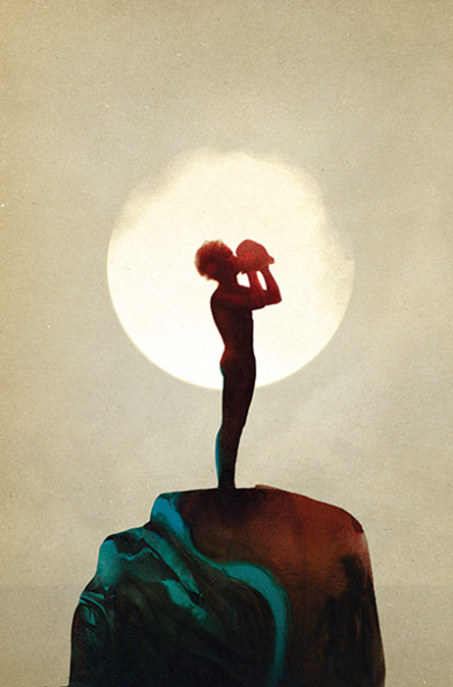
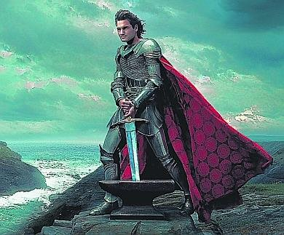
The Role of Archetypes
What roles do these archetypes serve?
  They help their audiences recognize various character types.

Slide 6
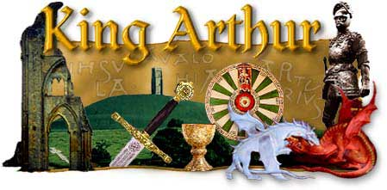
Legend of King Arthur
A Brief Introductory Synopsis to the

Slide 7
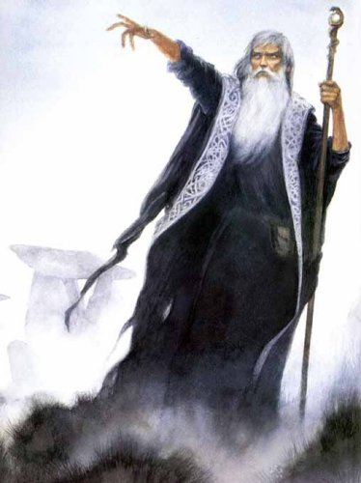
The Birth and Childhood of Arthur
Uther Pendragon, the Briton’s King, fell in love with the wife of another man; Merlin then disguises him to look like her husband for the affair to materialize (Pyle 17).
A child is then brought forth. He is Uther’s second child and first son.
Shortly after, King Uther passes; Merlin takes the child into his care and hides and protects him.
This child is Arthur. Merlin gives him to one peasant to raise him as one of his.
As Arthur grew along, he was unaware of hic royal background.

Slide 8
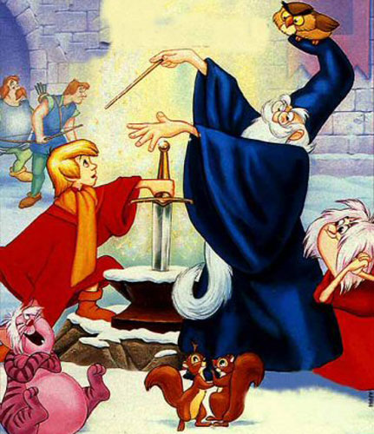
The Sword in the Stone
After the passing of King Uther, Merlin drives the Excalibur sword (which Merlin received from the Lady of the Lake) into a big rock with a curse that the sword would be only removed by the rightful king (Pyle 65).
Arthur, needing a sword for one of the adoptive brothers, pulls the Excalibur sword from the cursed rock.
He then proves as the king.

Slide 9
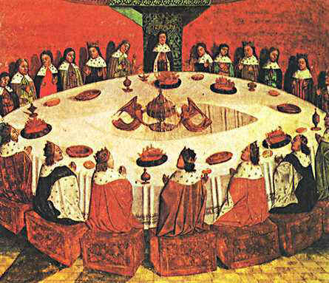
First Challenge of the New King
At Arthur's assumption of power, England was fractionated into city states, torn by war, and faced an incessant threat of attack from the Saxons
After getting married, King Leodegrance – Arthur’s father law – gifts Arthur a round table.
It was once a prized possession of his father’s.
The table sat hundreds of nights.

Slide 10
Continued….
The fabled story also features how Arthur used the table. It is at this table that a revolutionary idea is born (Pyle 113).
Arthur gathers all the Knights of the city states at the Round Table seeking their unity in defeating the Saxons; he creates the Knights of the Round table.
That no one knight, including King Arthur himself, held more power than the other. He then creates a democratic society (117).
He then leads the alliance of the Knights into war against the powerful Saxons in a series of 12 battles. He wins the war.
The legend foretells that it is through the use of the Excalibur sword that King Arthur realizes victory. The Excalibur sword is said to have made its barer invincible.

Slide 11
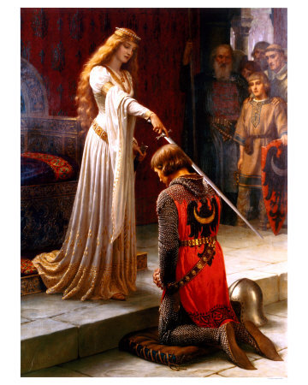
Princess Guinevere
King Arthur chose the beautiful Princess Guinevere to be his bride.
Merlin foresaw the disastrous ending to this relationship.
As tradition dictates, Guinevere, is left with no choice nor sees her husband to be before the wedding.
Guinevere and other members of the court pay special attention to the young and talented Knight Lancelot (Littleton & Malcor 71).
Knight Lancelot later becomes of the closest and favorite friends of King Arthur.

Slide 12
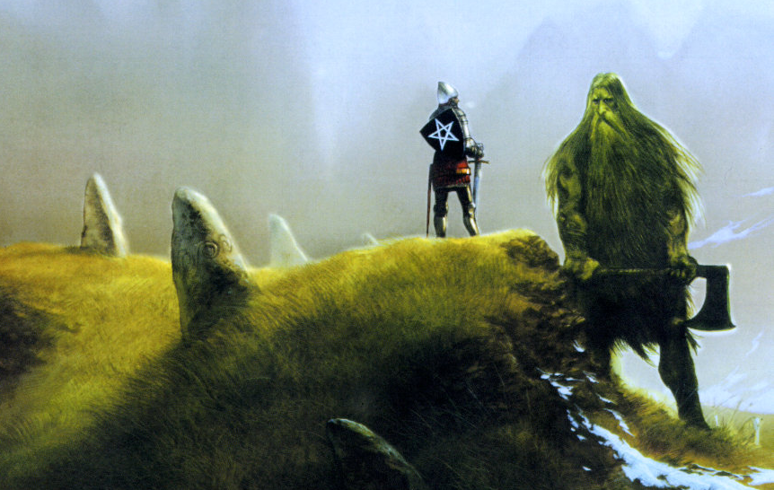
Among the other fables that focus on the other Knights of the Roundtable is Sir Gawain and the Green Knight. It is foretold when the kingdom is peaceful, when Arthur is happily married to Guinevere and has established the Round table (Carley 92).
Note: Gawain is the Nephew of Arthur, a son to Guinevere’s sibling.

Slide 13
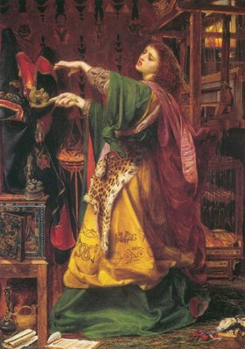
Evil Plots and Other Mysteries
Evil plots and mysteries;
  When Camelot was experiencing peace, the kingdom’s other parts were restless.
  Unknowingly to Arthur, he had a half sister, Morgan de Fey. Morgan is said to have been a powerful witch.
  She believed that she was the rightful heir to the throne as she was King Uther’s first child. In her attempts to usurp the throne, she slept and conceived a child with King Arthur.
  Her son, Mordred, threatened the throne and marriage of Arthur.

Slide 14
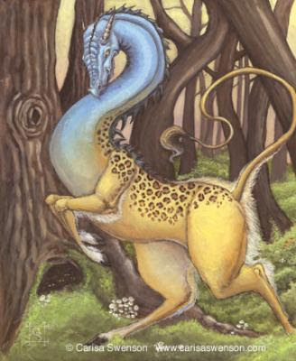

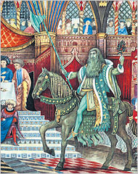
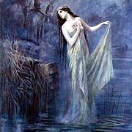
Evil Plots and Other Mysteries
Each good legend has several parallel stories.
  Camelot is foretold to be surround by innumerable chivalry stories, monsters, magic, and fairies.
  The most famed include (Carley 104):
    Tristan and Isolde;
    The Lady of the Lake;
    The Questing Beast;
    and The White Stag.

Slide 15
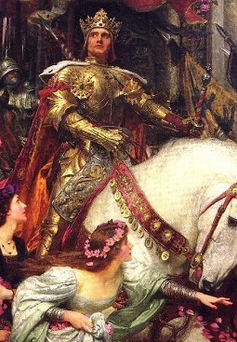
The Kingdom’s Religious Division
Arthur might have evidently been a member of the Celtic, an Olde religion within Britain – as evidenced by the keeping of Merlin, his royal wizard.
In this time, however, the new religion of Christianity was beginning. Princess Guinevere was a member of this religion.
King Arthur and his wife princess Guinevere experienced troubles conceiving. Guinevere held the belief that this was God’s punishment for Arthur’s pagan beliefs and his efforts to encourage his people to pray to pagan gods.
Arthur then established crusades as an effort to heal the country, which again had grown restless and remedy the problem of failing to conceive an heir.

Slide 16

The Holy Grail and the Crusades
Since Celtic beliefs were based on nature and tangible items, Arthur sought out to acquire as many artifacts as possible to convince the country to convert to Christianity (Jones 10).
Arthur, as helped by merlin, sent out his knights on quests for religious paraphernalia; these were referred to as crusades.
  The Temple of king Solomon
  The Holy Rodd
  The Spear of Destiny
  The Body of Joseph of Arimathea
  The Holy Grail
  Brazintine Crown of Thorns

Slide 17
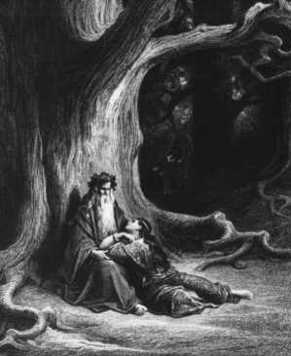
Turmoil in the Kingdom
Arthur’s search for the Holy Grail had him in far lands for prolonged periods. Some versions of the legend have him away for 10-20 years; Arthur’s life begins to fall apart.
It is during these times that Merlin was seduced by a young lustrous woman who stole his powers and imprisoned him. Arthur then is left with no advisor.
In the absence of Arthur, Mordred was raised to hate him; Arthur returns and unknowingly invites his son to The Round Table and knights him.
It is during Arthur’s absences that Guinevere also begins to realize her true love for Lancelot.

Slide 18
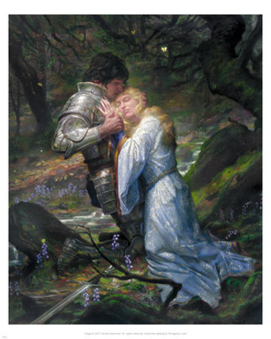
The Affair that Holds Most Fame in the Literary History
Mordred then sees Lancelot as a man opportunely positioned to overthrow his father (Pyle 217).
He (Mordred) later discovered the affair between Lancelot and Princess Guinevere (the two persons that Arthur treasure’s most) and convinces the knights in The Round Table to capture Lancelot in the act.

Slide 19
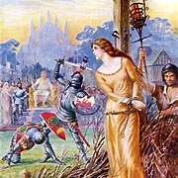
The Affair Continued….
Lancelot manages to escape (Barber 131).
However, Princess Guinevere unluckily gets captured and is sentenced to getting burnt for her treachery against the king (Jones 7).
A civil war then breaks between the two and their knight following.

Slide 20
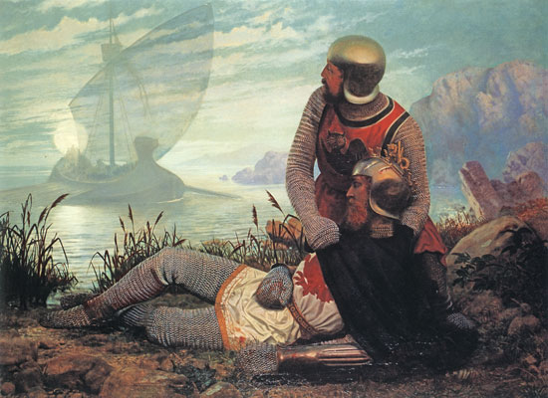
Camelot’s Fall
In a metaphorical sense, the country had already fallen after King Arthur had been betrayed by his best friend (Lancelot) and his love (princess Guinevere) (Barber 170).
Many versions of the story have been put forward. All end with the death of King Arthur in battle. Some of the versions postulate the following battles.
    The French
    The Goths
    The Romans
    The Irish
    The Saxons
    Mordred
    Morgan de fey
    Lancelot
King Arthur's death in battel is highly glorified; a death wish for any legendary hero(Barber 182).

Slide 21
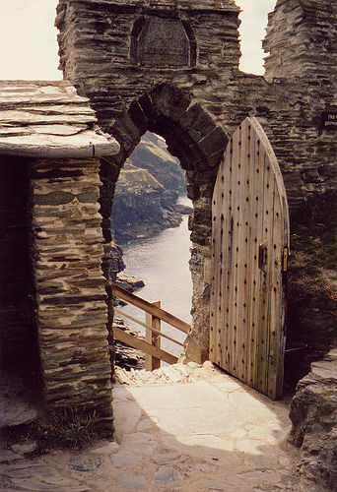
The Available True History
The scholarly world holds the believe that there was a King with the name Arthur who defeated the Saxons between the fifth or sixth centuries.
The imaginative and fanciful Historica Regum Britanniae, written in the twelfth century is an imaginative English accounts of the History of Geoffrey of Monmouth.
Castle ruins in Cornwall are postulated to have belonged to king Arthur
Otherwise little is known. All the Anglo-Saxon books, and similar history books lack accounts of Arthur.

Slide 22
Works cited
Pyle, Howard. The Story of King Arthur and His Knights. New York : Barnes & Noble, , 2016. Print.
Hardyman, Robyn, and Hope Killcoyne. What Is a Legend? Chicago: Britannica Educational Publishing, 2014.
Barber, Richard W. King Arthur: Hero and Legend. Woodbridge, Suffolk: Boydell, 1990. Print.
Carley, James P. "Polydore Vergil and John Leland on King Arthur: the battle of the books." Interpretations (1984): 86-100.
Jones, Thomas. "The early evolution of the legend of Arthur." Nottingham Medieval Studies 8 (1964): 3-21.
Littleton, C. Scott, and Linda A. Malcor. From Scythia to Camelot: A radical reassessment of the legends of King Arthur, the Knights of the Round Table, and the Holy Grail. Routledge, 2013.

